Slide 1
MENTORENESS INTERNSHIP PROGRAM
AIRPLANE CRASH ANALYSIS REPORT

Slide 2
Project Description
This internship project focuses on conducting a comprehensive analysis of airplane crashes and fatalities spanning from 1980 to 2023. The dataset contains crucial information such as crash dates, locations, operators, flight details, aircraft types, and fatality statistics. The goal is to leverage Power BI for interactive visualizations and in-depth insights to understand patterns, contributing factors, and trends in aviation incidents. The analysis aims to provide stakeholders with valuable information for enhancing aviation safety and mitigating risks

Slide 3

Tool Used
Power BI

Slide 4
Data Dictionary
Date | Date of the airplane crash
Time | Time of the airplane crash.
Location | Location where the airplane crash occurred
Operator | Operator or airline involved in the incident
Flight | Flight number associated with the incident
Route | Planned route of the flight
AC Type | Aircraft type involved in the crash
Registration | Registration details of the aircraft
cn/ln | Construction or serial number of the aircraft
Aboard | Total number of individuals aboard the aircraf
Aboard Passengers
Aboard Crew
Fatalities
Fatalities Passengers
Fatalities Crew
Ground
Summary

Slide 5
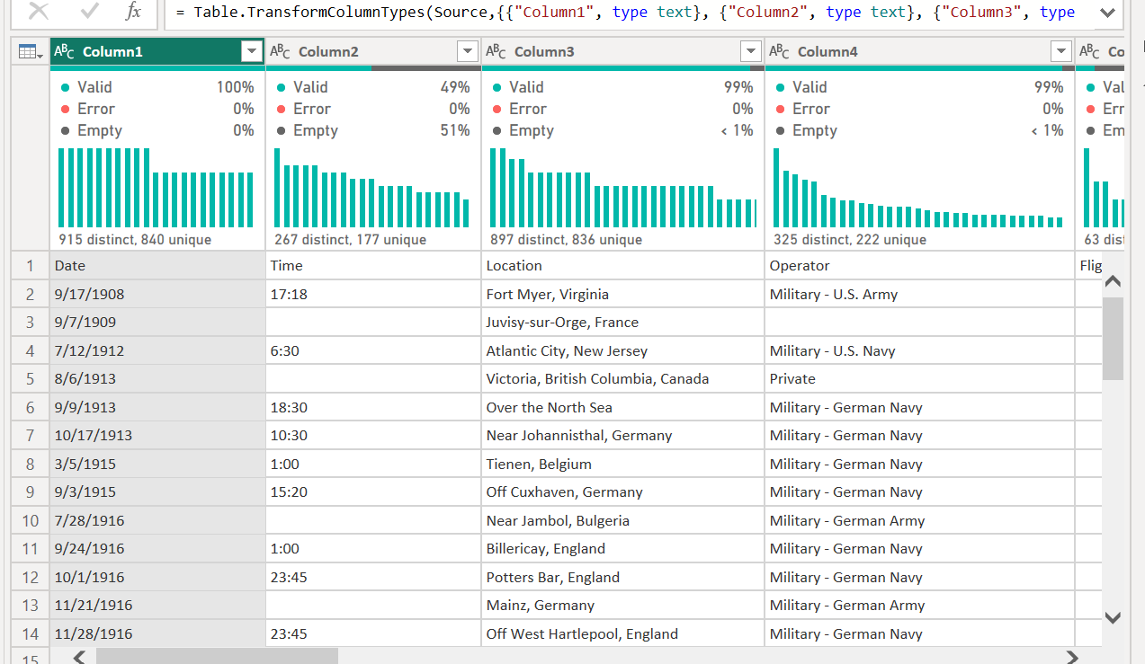
Raw Data in Power Query

Slide 6
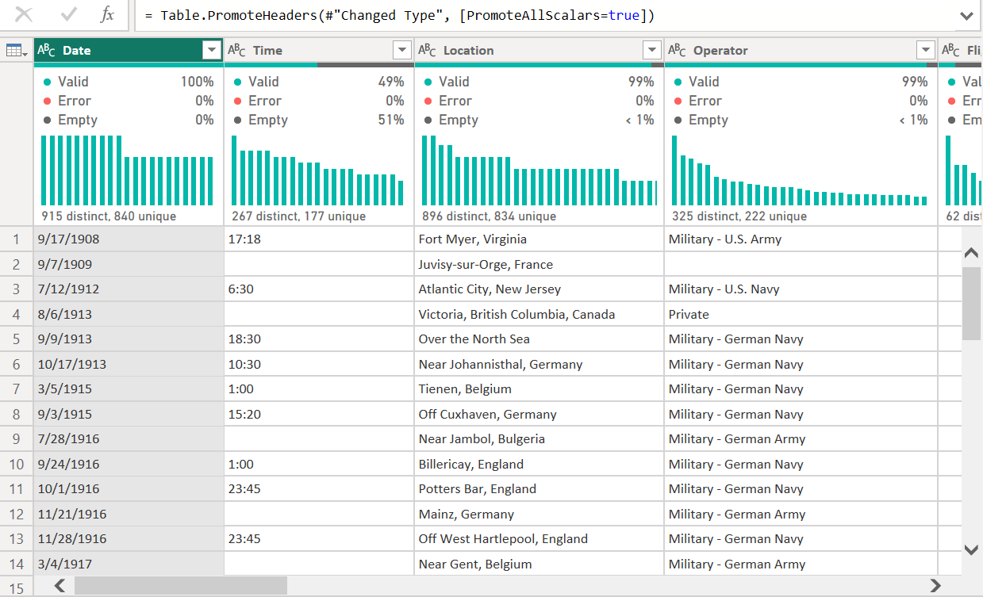
Data Transformation 1: I used the first row has header

Slide 7
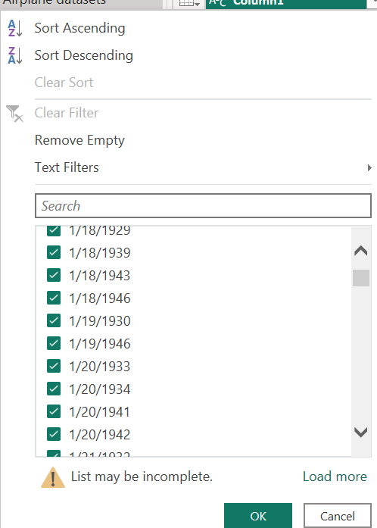
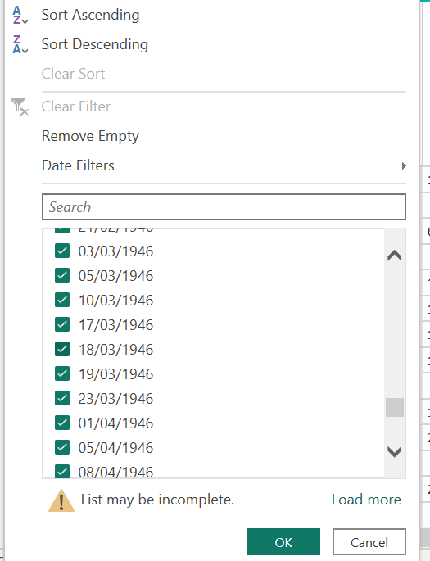
Data Transformation 2: Using Locale I changed the date data type

Slide 8
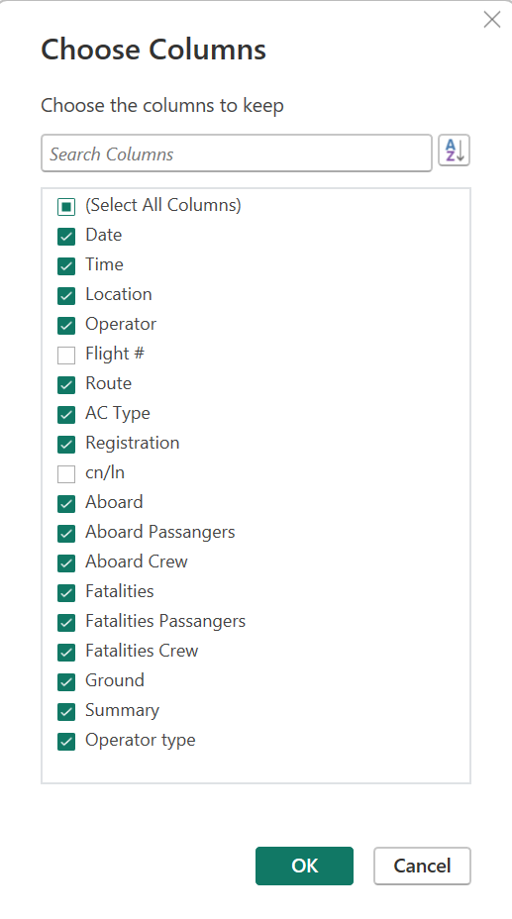
Data Transformation 3: Removed Flight and cn/in from the data

Slide 9
Data Transformation 4(Blank cells):

Slide 10
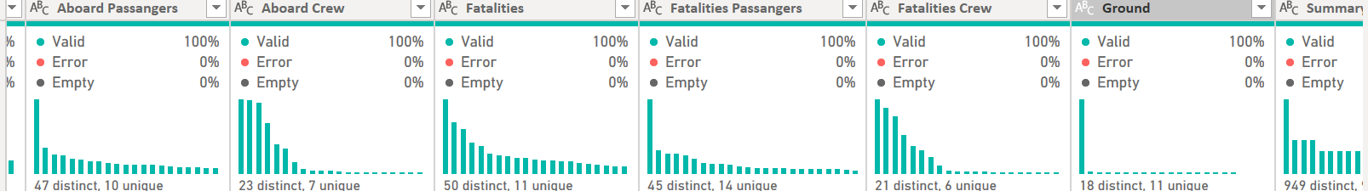
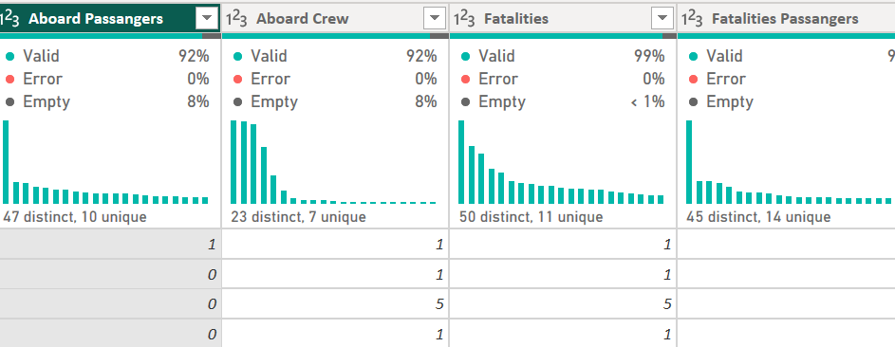
DATA TRANSFORMATION 5 : Change of data type
I converted wrong data type for some of the data for my analysis for example fatalities from text to Int

Slide 11
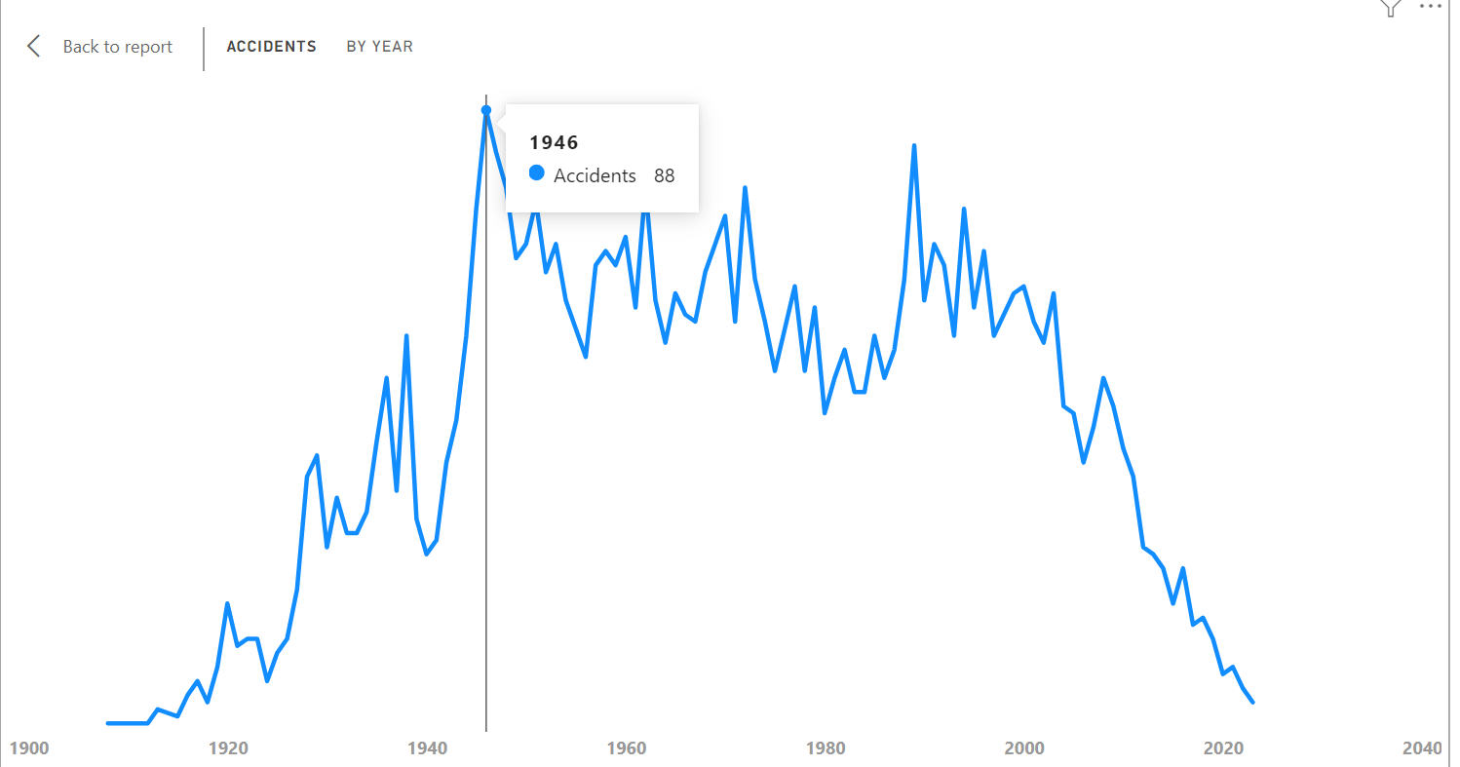
ANALYSIS USING DAX
Accidents = COUNTROWS('Airplane datasets’)
This Gives the total number of incidents recorded in our data sets
Then visualizing the cumulative accidents recorded over the years .
From the line chart 1946 recorded the highest number of accidents

Slide 12
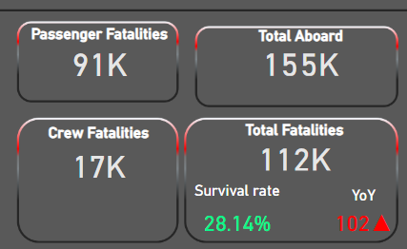
ANALYSIS USING DAX
Total fatalities = CALCULATE(
SUM('Airplane datasets'[Fatalities]),
'Airplane datasets'[Fatalities]<>BLANK()
)
this same concept was used for the other kpi’s
Amongst all the Kpi the crew fatalities was the lowest

Slide 13
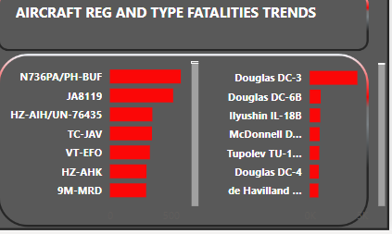
ANALYSIS
Comparing the Aircraft Registration and aircraft type
Fatalities trends

Slide 14
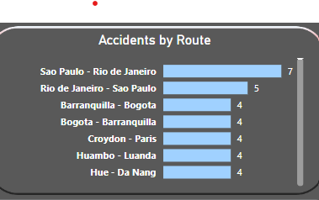
ANALYSIS
This gives the routes prone to accidents with sao paulo – rio de Janeiro taking the lead with 7 accidents recorded

Slide 15
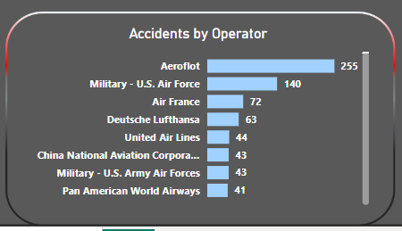
ANALYSIS
Accidents attributed to airline operators over the years

Slide 16
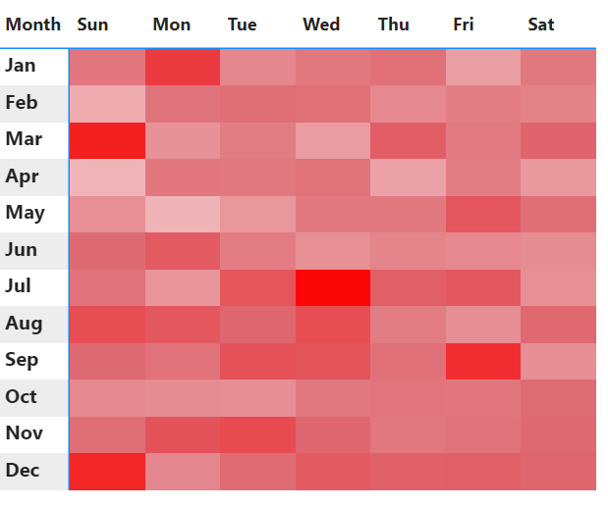
ANALYSIS
Cumulative Fatalities recorded over the months and weekdays
The darkest RED on the scale denotes high FATALITIES
The light red on the scale denote low FATALITIES

Slide 17
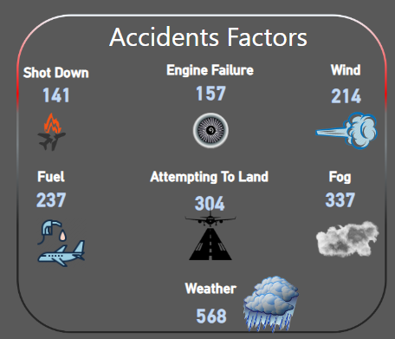
Causal Analysis
Weather =
COUNTX(
FILTER('Airplane datasets', CONTAINSSTRING('Airplane datasets'[Summary], "weather")),
'Airplane datasets'[Summary]
)
This expression calculates how many times the term "weather" appears in the 'Summary' column of the 'Airplane datasets' table.
This was also done for the others

Slide 18
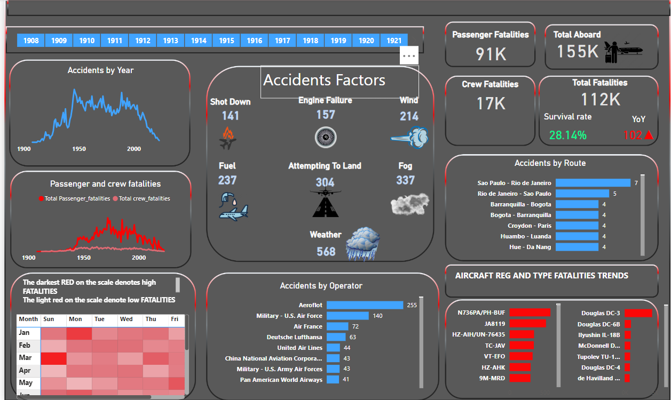
DASHBOARD FOR OUR ANALYSIS

